Slide 1
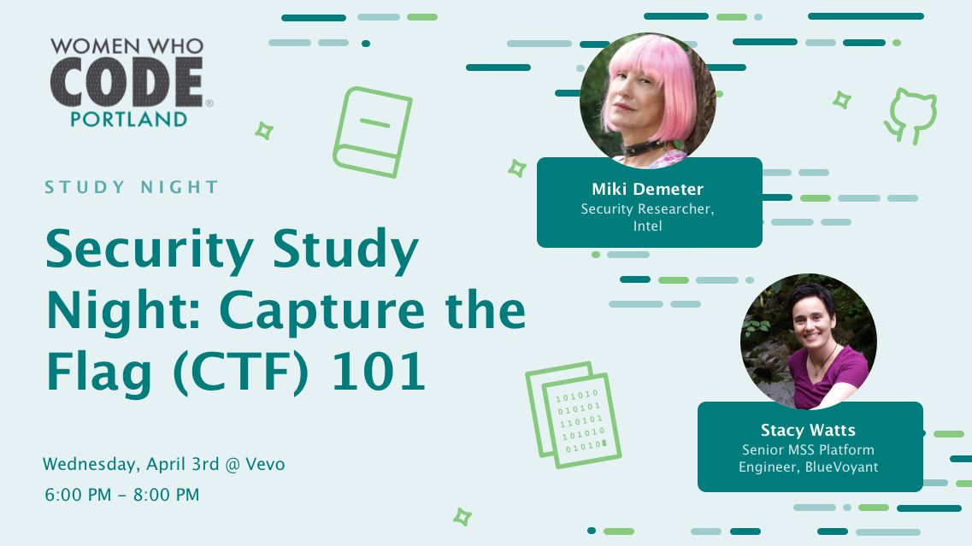

Slide 2
CTF 101
Hacker Kindergarten

Slide 3
Who is Miki
Hardware/Embedded Engineer
Software Engineer
Security Researcher @ Intel
Hacking nerd

Slide 4
Who is Stacy
Masters Computer Science Portland State University
Platform Engineer @ BlueVoyant
Security nerd
DevOps culture nerd

Slide 5
Survey
Who has heard of CTF?
Who has played CTF?

Slide 6
Types of CTF
Blue Team (CCDC, CDX)
Red Team (Jeopardy, Game-board)
Full Spectrum / Attack-Defense
Social Engineering

Slide 7
Why do we play CTF
Hone our skills
Develop new skills along the way
Think about SW in a different way

Slide 8
What you need to know?
Minimally: how to think critically.
Some familiarity with programming will be helpful, but many past participants of picoCTF have played with no programming experience and learned some programming along the way.
Exposure to Python, HTML, JavaScript, and C (though Java syntax is close enough for this purpose) is ideal, but in no way required.
CURIOSITY!!!!

Slide 9
What skills might I need to use
Reverse-engineering, network sniffing, protocol analysis, system administration, programming, and cryptanalysis are all skills which may be necessary for different problems

Slide 10
Time to get started

Slide 11
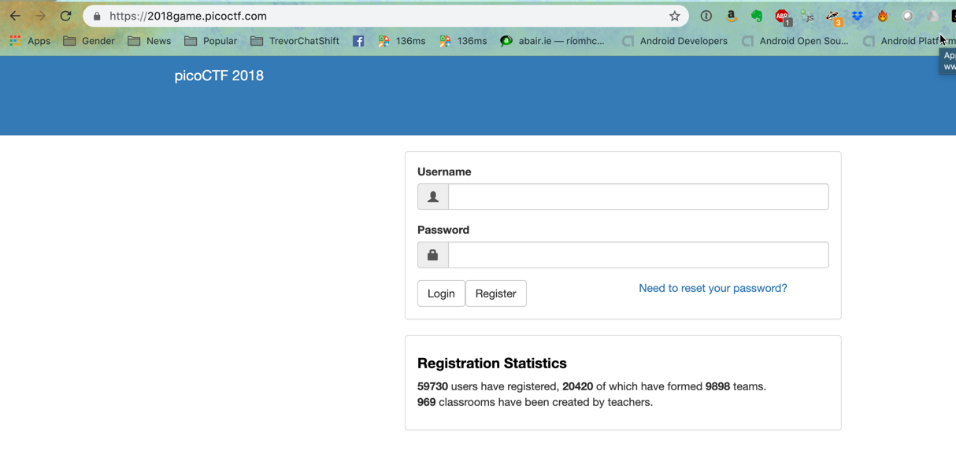
2018game.picoctf.com

Slide 12
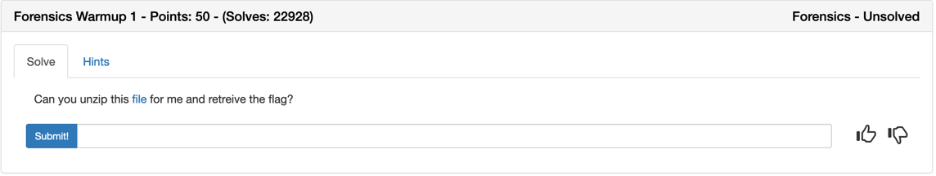
Lets capture our first flag

Slide 13


Slide 14
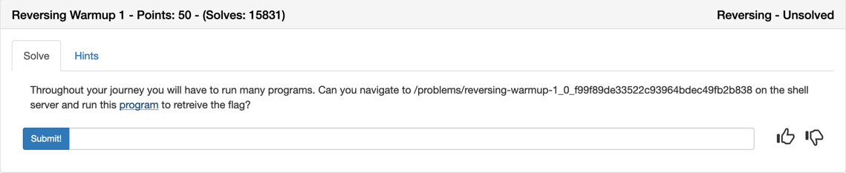
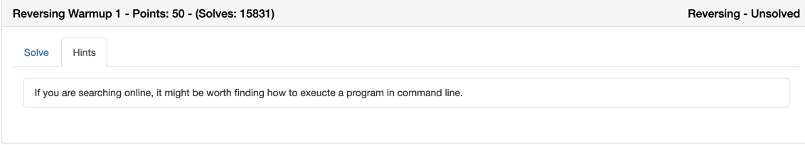
Warm up #1

Slide 15
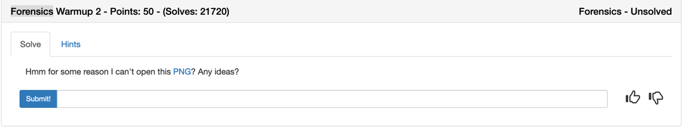
Lets figure this one out together

Slide 16
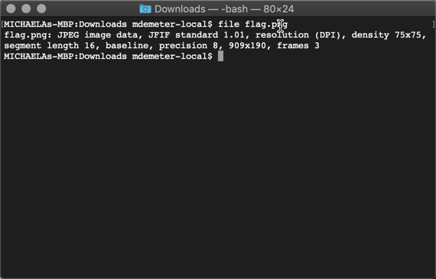

Slide 17


Slide 18
Let’s do one more together

Slide 19
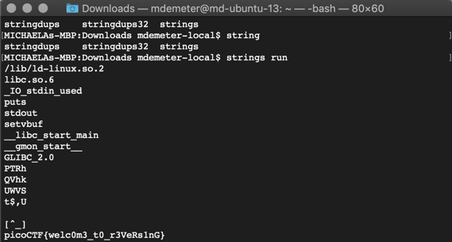

Slide 20
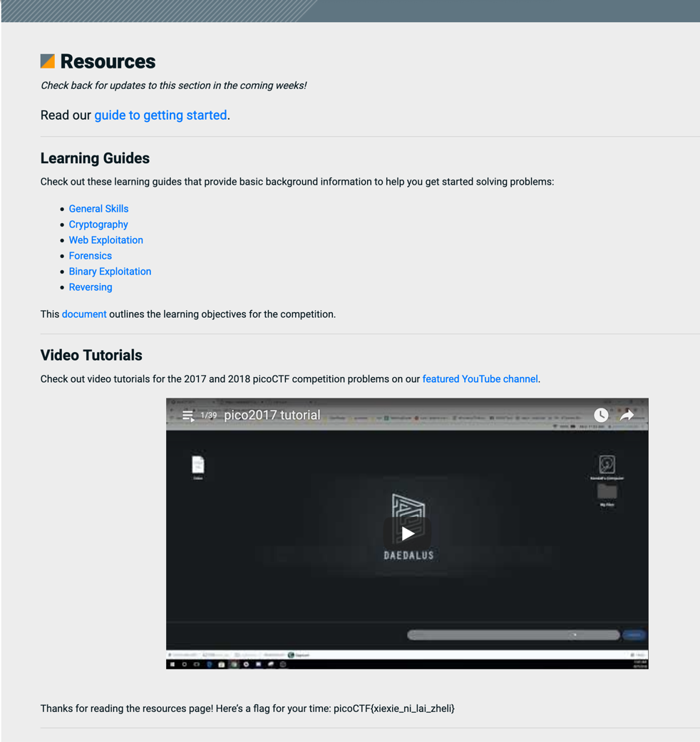

Slide 21
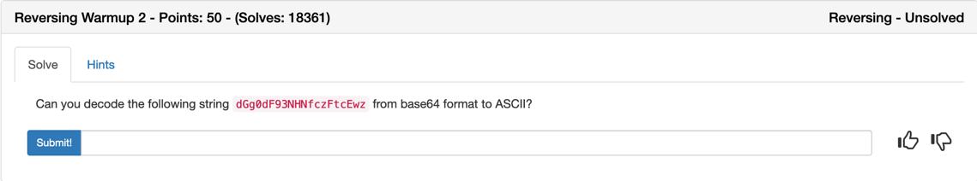
One more for fun

Slide 22
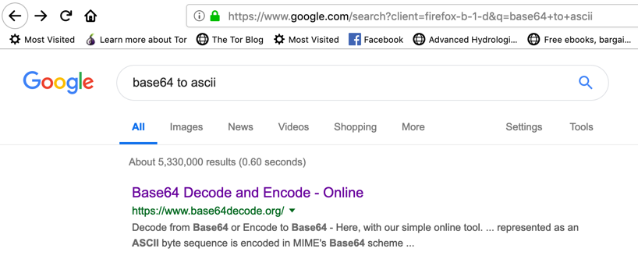
OSINT

Slide 23
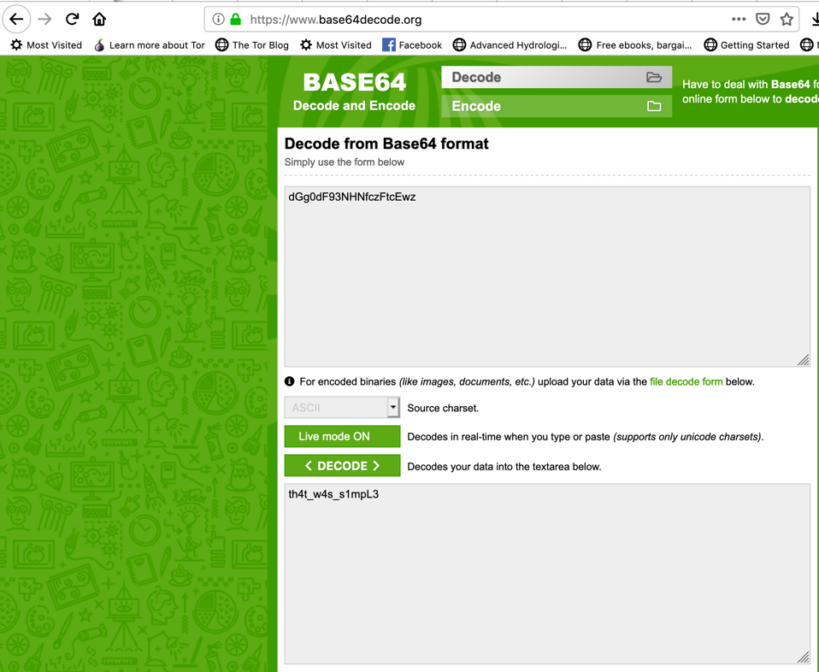

Slide 24
Can anyone give me another way

Slide 25
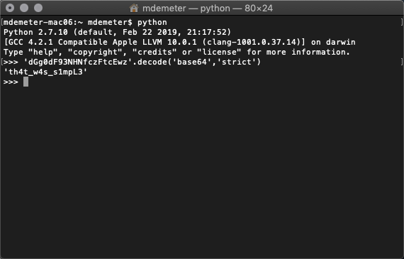
How About Python

Slide 26
Any others

Slide 27
Additional resources
Youtube
Ian Coldwater @IanColdwater

Slide 28
That’s all there is to it
Go have fun now
Miki Demeter
twitter: @theDawgCr8
email: sec-princess@unroutable.me
linkedIn: https://www.linkedin.com/in/mikide
github: https://github.com/sec-princess
Stacy Watts
twitter: @stacybird
email: dreamsong@gmail.com
linkedIn: https://www.linkedin.com/in/stacywatts/
github: https://github.com/stacybird

